Slide 1
SPEECH RECOGNITION: SPEECH-TO-TEXT WITH PYTHON & MATLAB.
Dan Otieno.
EE 384: Digital Signal Processing Lab.
EE 384: Digital Signal Processing Lab.

Slide 2
INTRODUCTION
Speech to text is technology that facilitates the conversion of human speech into written or typed text.
This can be achieved using speech recognition software and/or algorithms, many of which are available in the development environment.
Speech recognition (speech-to-text) converts audio data into data formats that data scientists use to get actionable insights for business, industry, and academia.
90% of the world’s data is unstructured; unsearchable and unorganized, most of which is voice or video data that needs to be changed into machine-readable data to be used for decision-making.
This project combines the functionalities of python and MATLAB to implement the conversion of speech into text format.
EE 384: Digital Signal Processing Lab.

Slide 3
WORKFLOW (in Windows).
INPUT SELECTION:
♦ On running MATLAB script, user is first prompted for a python file by browsing through file explorer, then to browse and select audio file (this is in wav format).
SIGNAL PREPROCESSING:
♦ MATLAB’s “audioread” function loads the wav file and extracts the audio signal and sampling frequency (y and Fs respectively).
♦ The extracted signal is preprocessed to address issues, with methods such as normalization or noise reduction.
SIGNAL VISUALIZATION:
♦ Using the “plot” and “spectrogram” MATLAB tools, signal waveform and spectrogram are generated.
♦ The waveform plot provides insights into the amplitude variations of the audio signal over time, while the spectrogram plot reveals its frequency content.
SPEECH-TO-TEXT CONVERSION:
♦ MATLAB calls the Python script using the system function and passes the audio file path as an argument.
♦ Python utilizes the “speech_recognition” library and the Google Speech Recognition API to transcribe the audio signal into text and the result is returned to MATLAB for further processing.
OUTPUT HANDLING:
♦ MATLAB displays the transcription result and additional information, such as audio length and processing time, in the console window; that output is also saved to a text file.
♦ Any errors encountered during the speech-to-text conversion process (if any) are also displayed in the console window.
EE 384: Digital Signal Processing Lab.

Slide 4
ALGORITHMS USED.
SHORT-TIME FOURIER TRANSFORM (STFT):
♦ The STFT algorithm is used in the MATLAB “spectrogram” function to perform calculations for the signal spectrogram. STFT divides the audio signal into short overlapping segments and computes the Fourier Transform for each segment to analyze its frequency content over time. Due to the time-frequency representation of the signal, we can visualize the frequency components evolving over time.
SPEECH RECOGNITION ALGORITHM:
♦ Sourced from GitHub, the speech recognition algorithm used in the Python script utilizes the Recognizer class from the speech_recognition library. The algorithm typically involves processing the audio signal to extract relevant features such as mel-frequency cepstral coefficients (MFCCs), fundamental frequency (pitch), and formants.
♦Those extracted features are used to train or feed into a machine learning or statistical model, which maps them to textual representations using techniques like Hidden Markov Models (HMMs), deep neural networks (DNNs), or recurrent neural networks (RNNs).
GOOGLE SPEECH RECOGNITION API:
♦ Also utilized by the Python script utilizes to perform the actual transcription of the audio signal.
♦ This API combines advanced algorithms developed by Google to accurately transcribe speech into text, using deep learning techniques and large training datasets to achieve high accuracy in recognizing various spoken languages and dialects.
EE 384: Digital Signal Processing Lab.

Slide 5

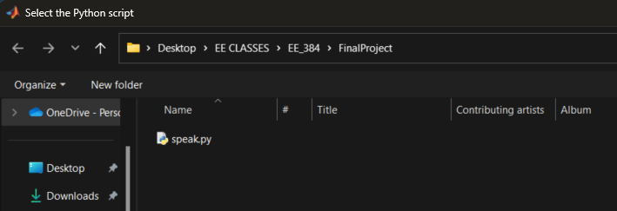
EXAMPLE (in Windows).
1. Start by running the MATLAB script, I type the script title in the MATLAB command line.
2. Prompt to browse and select python file.
EE 384: Digital Signal Processing Lab.

Slide 6
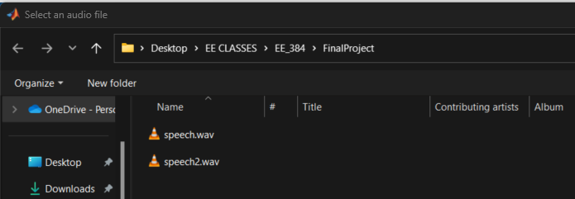
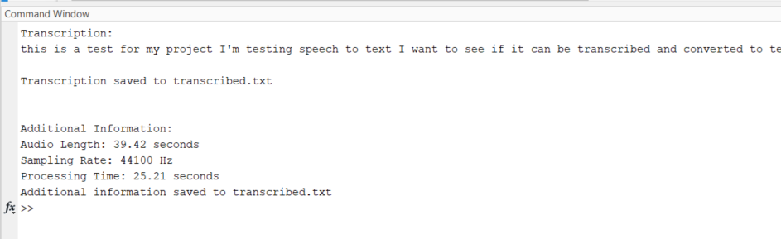
EXAMPLE (in Windows).
3. Prompt to browse and select audio file, I will use “speech2.wav”.
4. Command window output.
EE 384: Digital Signal Processing Lab.

Slide 7
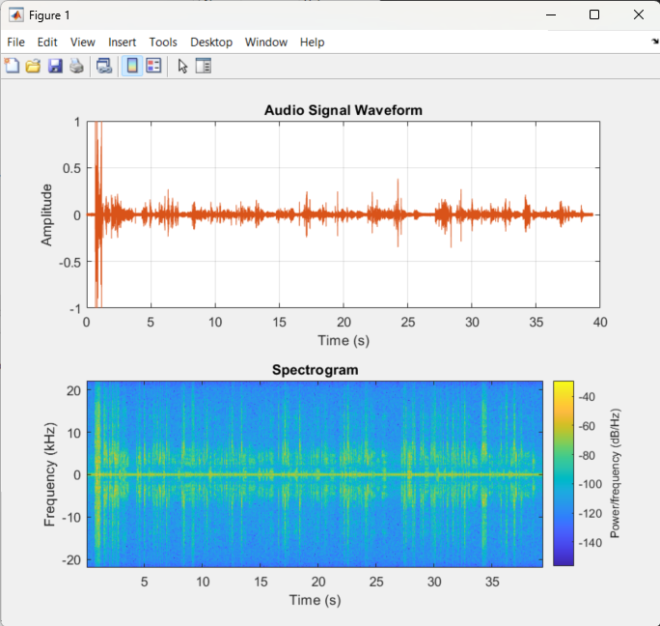
EXAMPLE (in Windows).
5. Generated Waveform and Spectrogram.
EE 384: Digital Signal Processing Lab.

Slide 8
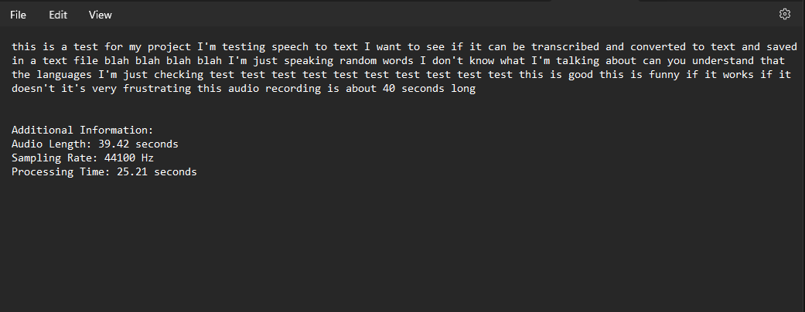
EXAMPLE (in Windows).
6. Copy of “transcribed.txt” showing output similar to command window.
EE 384: Digital Signal Processing Lab.

Slide 9
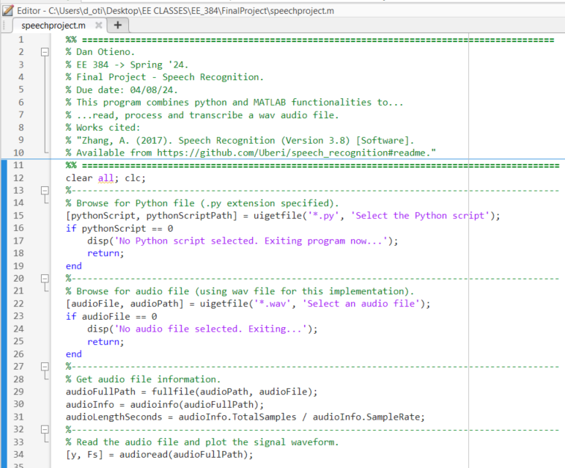
CODE SNIPPET - MATLAB.
EE 384: Digital Signal Processing Lab.

Slide 10
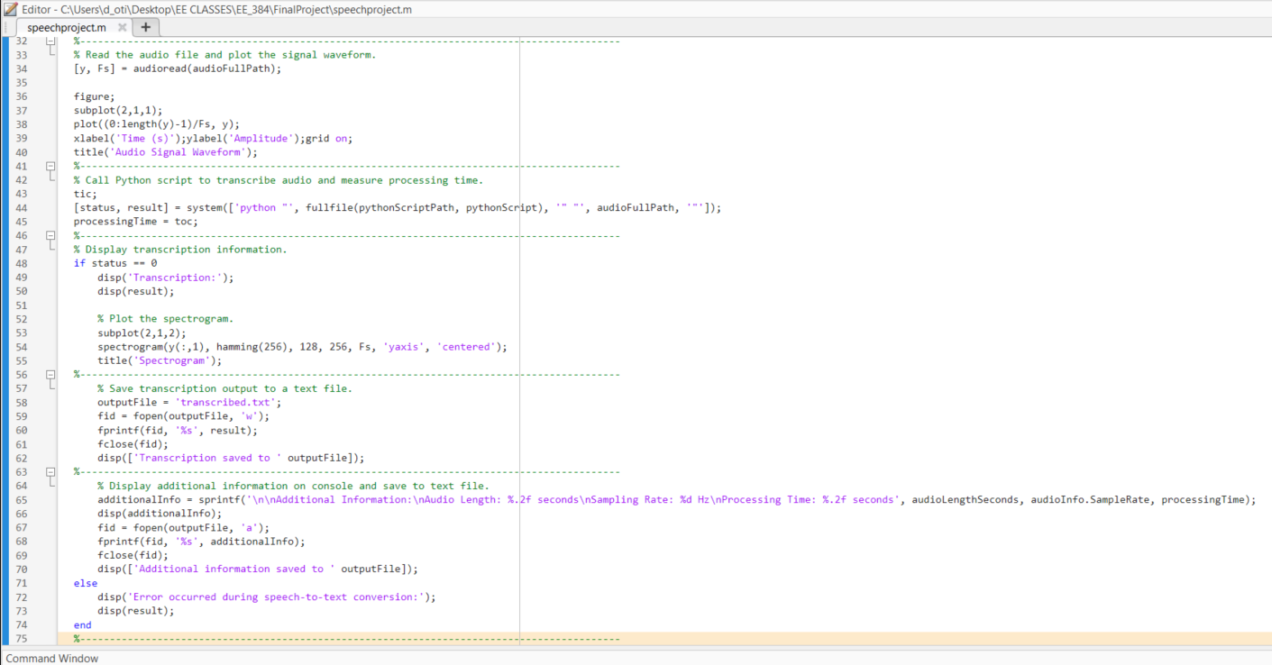
CODE SNIPPET - MATLAB.
EE 384: Digital Signal Processing Lab.

Slide 11
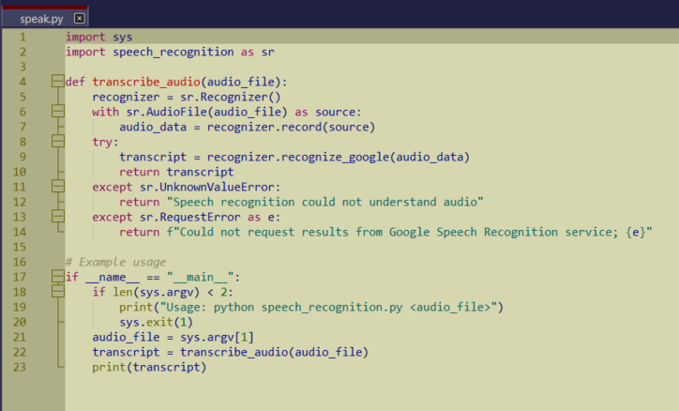
CODE SNIPPET - PYTHON.
EE 384: Digital Signal Processing Lab.

Slide 12
WORKS CITED & REFERENCES.
https://deepgram.com/learn/best-python-audio-libraries-for-speech-recognition-in-2023
Zhang, A. (2017). Speech Recognition (Version 3.8) [Software]. Available from https://github.com/Uberi/speech_recognition#readme.
Mohan, V. (2013). Analysis and Synthesis of Speech using MATLAB‖. International Journal of advancements in Research and Technology, 2, 373-382.
Amos, D. (2016). The ultimate guide to speech recognition with python. Real Python.
Anggraeni, D., Sanjaya, W. S. M., Nurasyidiek, M. Y. S., & Munawwaroh, M. (2018). The implementation of speech recognition using mel-frequency cepstrum coefficients (MFCC) and support vector machine (SVM) method based on python to control robot arm. In IOP Conference Series: Materials Science and Engineering (Vol. 288, No. 1, p. 012042). IOP Publishing.
EE 384: Digital Signal Processing Lab.

